Slide 1
CSE-299 SEC-02 FALL’20
ILMIAT FARHANA
1712428042

Slide 2
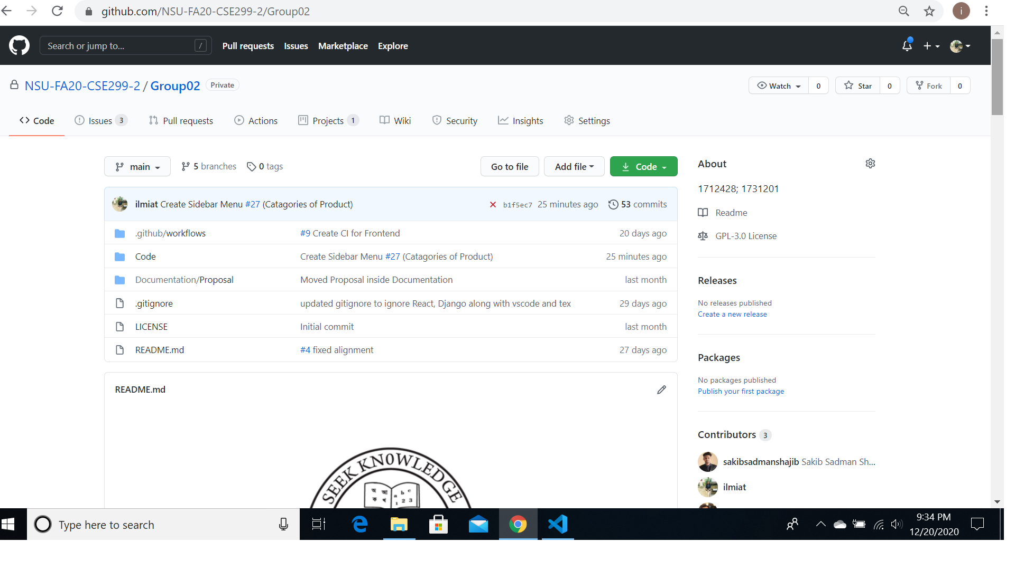
README

Slide 3
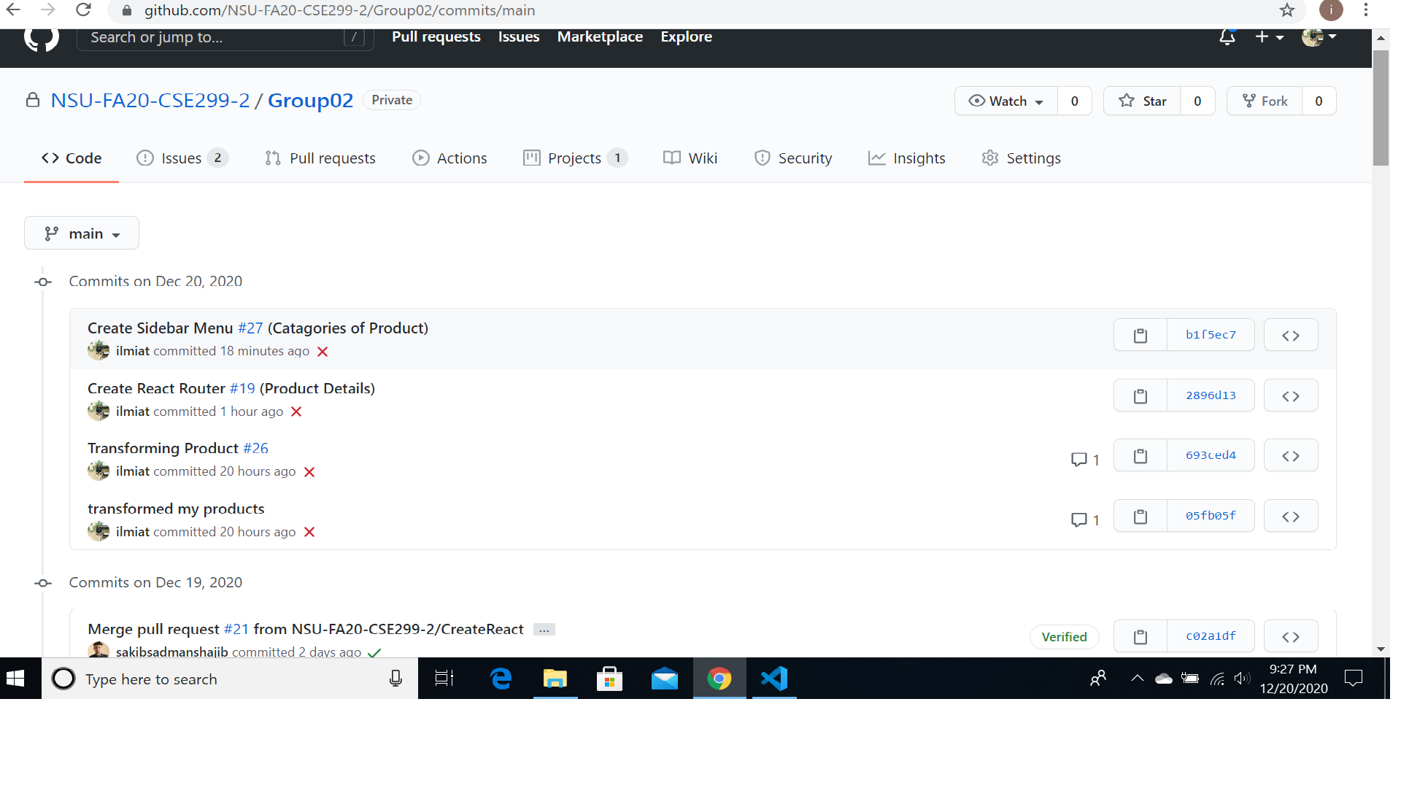
COMMITS

Slide 4
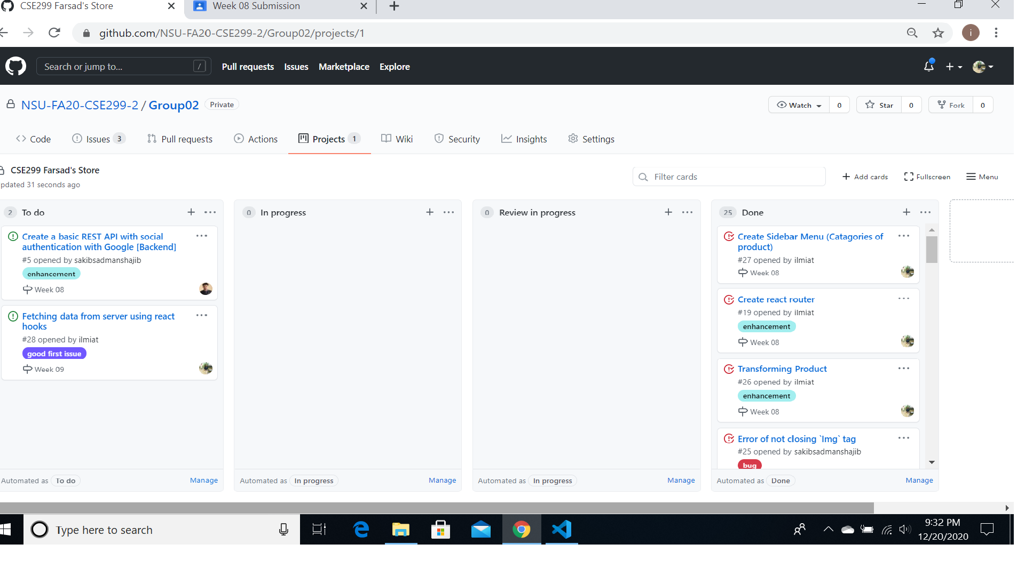
ISSUEBOARD

